Slide 1
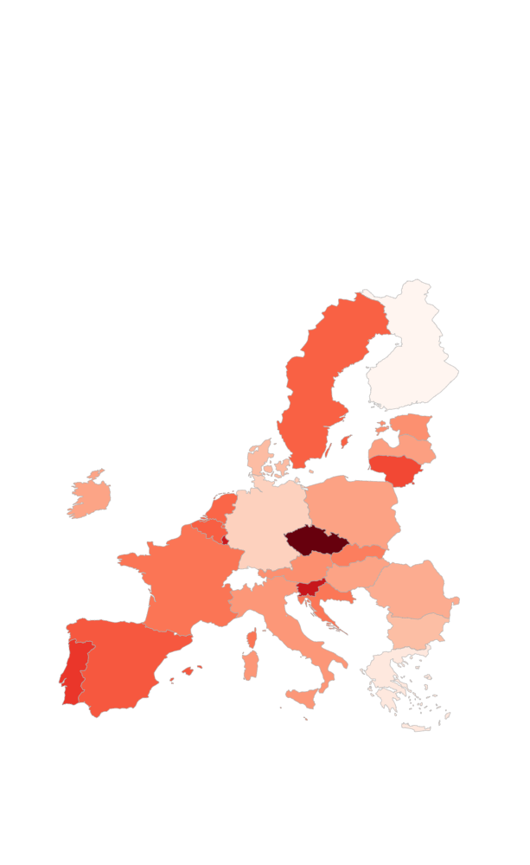

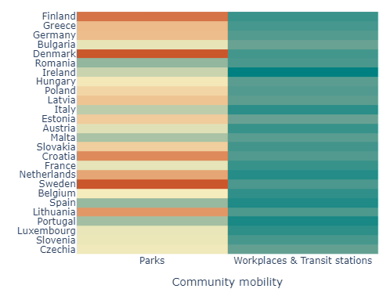
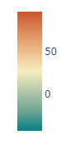
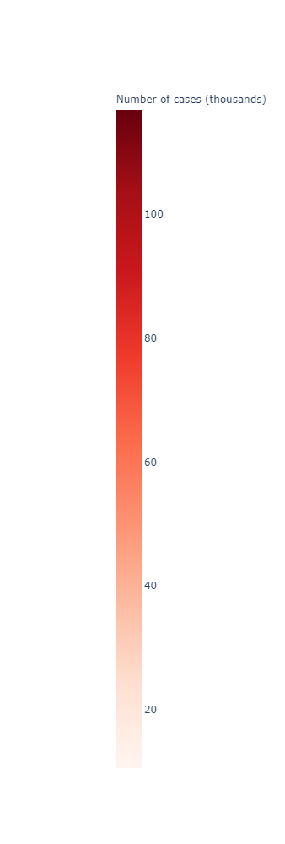

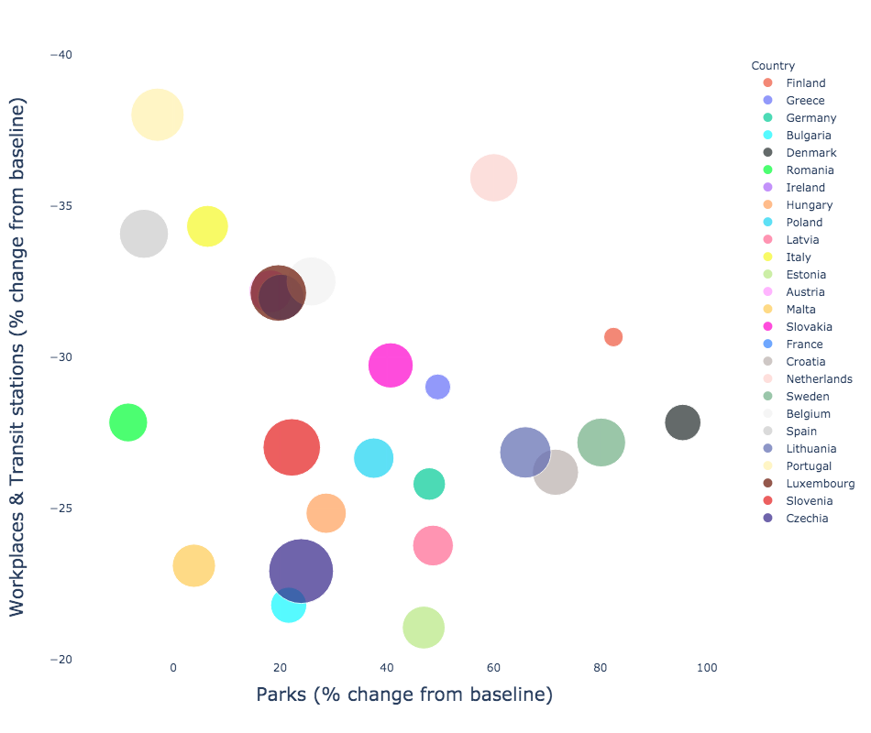
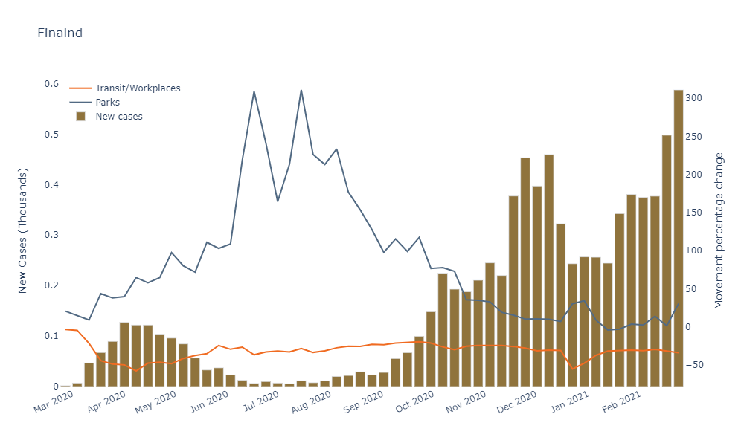
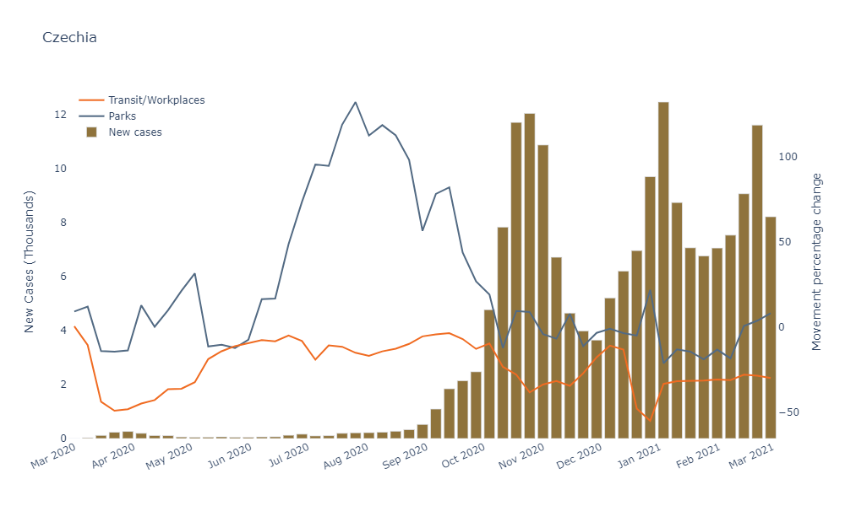
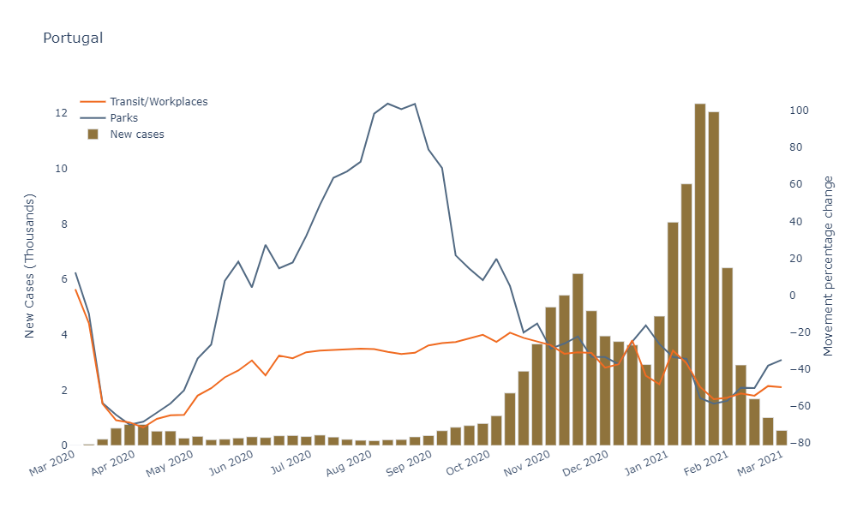
MOVING WITH COVID-19
How did EU communities change their mobility with COVID-19?
.
On 31 December 2019, the WHO was informed of cases of pneumonia of unknown cause in Wuhan City, China. Seven days later a novel coronavirus was identified as the cause by Chinese authorities and on the 30th of January 2020, the coronavirus outbreak was declared a public health emergency of international concern, WHO's highest level of alarm. On the 11th of March 2020, over 118 000 cases had been reported in 114 countries, and 4291 deaths had been recorded. This rapid increase in the number of cases outside China led the WHO to announce that the outbreak could be characterized as a pandemic!
What is Covid19?
« Coronavirus disease (COVID-19) is an infectious disease caused by a newly discovered coronavirus »
- World Health Organization
EU – European Union
Analysis period – All data in the present analysis refers to the period between the 25th February 2020 and the 2nd March 2021.
Analysis area – This analysis is focused in European Union countries.
Baseline – Represents a normal value for that day of the week It is the median value from the 5 week period Jan 3 – Feb 6, 2020.
Parks – Includes public gardens, castles, national forests, camp grounds and observation decks. Parks typically means official national parks and not the general outdoors found in rural areas.
Percent change from baseline – Percent change in the number of total visitors compared to the baseline.
Workplaces & Transit stations – Includes subway stations, sea ports, taxi stands, highway rest stops and car rental agencies.
01 HOW IS EU DOING?
df
EU Communities Mobility
EU COVID-19 cases per million inhabitants
Lowest number of new cases (Finland)
GLOSSARY
Percent change from the baseline
Highest number of new cases (Czechia)
Overall reduction of visits to Workplaces & Transit stations across EU
02 MOBILITY VS COVID-19
Best and worst performing EU countries
Average daily new cases per week & Mobility indicators
EU countries by Mobility indicators
Highest number of park visits
Decrease on Average daily new cases
Best performing country (Finland)
Bubble size represents the number of new cases per million inhabitants
Decrease on Workplaces & Transit stations visits
Worst performing country (Czechia)
03 HOW ARE WE DOING?
04 CONCLUSIONS
The case of Portugal
Average daily new cases per week & Mobility indicators
The country reached the highest number of daily cases per week (12,000+) in Feb 2021.
Finland (EU’s best performing country) reduced its community movements in a more consistent way when compared to Czechia (EU’s worst performing country).
Consistency seems to be a key for success!
The fact that cases start growing when visits to parks reduce might be related to behaviour population during May 2020 into September 2020, which visits were bigger.
Since the pandemic started, Portuguese community has reduced its visits to Workplaces & Transit stations by over 10%.
Most of the best performing countries fighting the pandemic crisis had their communities visiting the Parks more often.
Countries with bigger changes in mobility profile, presented better COVID-19 scenarios
Overall, all EU communities decreased their visits to Workplaces & Transit stations since COVID-19 started.
Currently it is the 4th worst performing EU country in terms of new cases per million inhabitants
Currently it is the 5th worst performing EU country in terms of deaths per million inhabitants.
With a sudden reduction in the visits to Workplaces & Transit stations, we can see a direct impact on the number of new cases.
The reduction of the number of visits to Workplaces & Transit stations and the increase of Parks visits seems to be a good formula to fight the pandemic!
Dataset source:
https://ourworldindata.org/coronavirus-source-data
Authors:
Diana Furtado (m20200590); Hiromi Nakashima (m20201025); Miguel Martins (m20200671); Sofia Simão (m20200639)

